Slide 1

A
PROJECT REPORT
ON
Vulnerability Assessment and Penetration Testing
SUBMITTED BY
GROUP NO : 05
AJEYPALSINH JADEJA - 20082291039
RIYAKUMARI PATEL – 20082291017
B.Sc.IT (CYBER SECURITY) SEMESTER – VI
U66A1IP2 - INDUSTRIAL PROJECT – II

Slide 2
ACKNOWLEDGEMENT
We take this opportunity to humbly express my thankfulness to all those concerned with our project " Vulnerability Assessment and Penetration Testing “. We are thankful to Ganpat University for giving us opportunity to develop the Project.
Secondly, we are thankful to Department of Computer Science, Ganpat University, Kherva to provide the excellent environment to us for develop the project.
We express our deep sense of gratitude towards our guides, Prof. Krima Patel And for their keen interest in each stage of our project development, their guidance encourages us to developing the project in the right way.
Finally, we are thankful to all those people who have helped us directly or indirectly in completing this project successfully.

Slide 3
CONTENTS
SR. NO. | PARTICULARS | PAGE NO.
1 | Project Profile | 05
2 | Introduction | 07
 | 2.1 Overview | 07
 | 2.2 Background and Motivation | 08
 | 2.3 Objective | 09
 | 2.4 Methodology | 10
3 | Hardware and Software Requirement | 11
4 | Tool Description | 13
5 | Functional Specification | 15
 | 5.1 Insecure Database Storage in Android (Reverse Engineering) | 17
 | 5.2 OTP Bypassing (Brute Force) | 28

Slide 4
 | 5.3 SQL Injection | 38
 | 5.4 Cleartext Transmission of Sensitive Information | 47
 | 5.5 No Rate Limit on Current Password Field | 52
 | 5.6 HTML Injection | 56
 | 5.7 XSS (Cross – site Scripting) | 61
 | 5.8 Click Jacking | 66
 | 5.9 Directory Traversal | 73
 | 5.10 No Rate limiting on Admin Login page | 80
 | 5.11 Dos Attack | 89
 | 5.12 Css Injection | 96
 | 5.13 PHP Version Disclosure | 101
6 | Future Scope | 105
7 | Reference | 106

Slide 5
1.PROJECT PROFILE
Project Title :- | Vulnerability Assessment and Penetration Testing
Objective :- | To perform internal vulnerability assessment. To perform external vulnerability assessment.
Perform By:- | AJEYPALSINH JADEJA – 20082291039 RIYAKUMARI PATEL - 20082291017
Internal Guide :- | Prof. Krima Patel
Group No :- | 05

Slide 6
Operating System :- | Kali Linux (2023.1) Window (Windows 10) Android (Android 13)
Tools :- | APKTool (2.7.0) Dex2jar (2.1) Burp-suite (2022.2.4) SQL Map Google Dorks Hping3 (3.a2.ds2)

Slide 7
2.1 OVERVIEW
The adoption of technology to gain speedy growth of IoT, mobile applications, has made the networks more vulnerable than ever. VAPT methods are designed to support users to authenticate their enterprise-level security against the real-world threat, recognize the risks of the system and the network and know the consequences of these flaws. Every industry spends a fair amount of share in their security systems. Taking charge and confirming the reliability and robustness of the processes is highly important. VAPT services help improve networks and immune the security system and guard it against hackers
A Mobile Application Penetration Test is an authorized and simulated hacking attempt against a native mobile application such as Android, the purpose of this test is to identify and exploit vulnerabilities in an application, and the way it interacts and transfers data with the backend systems

Slide 8
2.2 BACKGROUND AND MOTIVATION
The evolving tools, tactics and procedures used by cybercriminals to breach networks means that it is important to regularly test your organization’s cyber security. VAPT helps to protect your organization by providing visibility of security weaknesses and guidance to address them. VAPT is increasingly important for organizations wanting to achieve compliance with standards including the GDPR, ISO 27001 and PCI DSS.
Mobile applications have become important part of day-to-day life as everyone is using smart phones now a days. Cyber security may often become false perception in case if we do not know how our apps were developed as well as penetration testing. The simplest way to identify and avoid cyber risk is to perform mobile app penetration testing

Slide 9
2.3 OBJECTIVE
The objective of performing a Vulnerability Assessment is to create an overview of the security risks to a network and then use that overview as a guideline to resolve those threats.
Performing regular assessments and routinely resolving all security risks provides a baseline security for the network.
Ultimately, the goal is to identify security weaknesses in a network, machine, or piece of software.
Once caught, the people maintaining the systems or software can eliminate or reduce the weaknesses before hostile parties discover them.

Slide 10
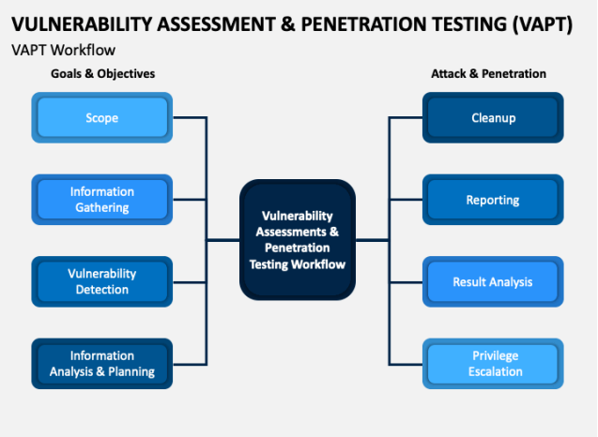
2.4 METHODOLOGY

Slide 11
3.HARDWARE REQUIRMENT
Processor | 1.6 GHz
RAM | 8 GB
Free Hard disk space | 40 GB

Slide 12
3.SOFTWARE REQUIRMENT
Operating System | Android Linux Window
Tools | APKTool, Dex2jar, Burp-suite, SQLMap, Hping3 Jd-Gui Google Dorks

Slide 13
4.TOOLS DESCRIPTION
APKTool | A tool for reverse engineering 3rd party, closed, binary Android apps. It can decode resources to nearly original form and rebuild them after making some modifications.
Dex2jar | Dex2Jar is a freely available tool to work with Android “.dex” and Java “.class” files.
Burp-suite | Burp Suite is an integrated platform for performing security testing of applications.

Slide 14
Jd-Gui | JD-GUI is a standalone graphical utility that displays Java source codes of “.class” files.
Hping3 | hping3 is a network tool able to send custom ICMP/UDP/TCP packets and to display target replies like ping does with ICMP replies.
Google Dorks | Google dorking is used to find hidden information that is otherwise inaccessible through a normal Google search.
SQL map | SQL Map is an open-source penetration testing tool that automates the process of detecting and exploiting SQL injection flaws and taking over of database servers.

Slide 15
FUNCTIONAL SPECIFICATION

Slide 16
Sr. No. | Vulnerability Name | Severity
01 | Insecure Database Storage in Android (Reverse Engineering) | CRITICAL
02 | OTP Bypassing (Brute Force) | HIGH
03 | SQL Injection | HIGH
04 | Cleartext Transmission of Sensitive Information | HIGH
05 | No Rate Limit on Current Password Field | HIGH
06 | HTML Injection | MEDIUM
07 | XSS (Cross – site Scripting) | MEDIUM
08 | Click Jacking | MEDIUM
09 | Directory Traversal | MEDIUM
10 | No Rate limiting on Admin Login page | MEDIUM
11 | Dos Attack | MEDIUM
12 | Css Injection | LOW
13 | PHP Version Disclosure | LOW

Slide 17
1 | Insecure Database Storage in Android (Reverse Engineering) | Risk Rating
 |  | CRITICAL
1.1 | Affected URLs:
1.2 | Impact
Insecure data storage vulnerabilities typically lead to the following business risks for the organization that owns the risk app: Identity Theft Fraud Reputation Damage External Policy Violation (PCI); or Material Loss.
1.3 | PoC

Slide 18
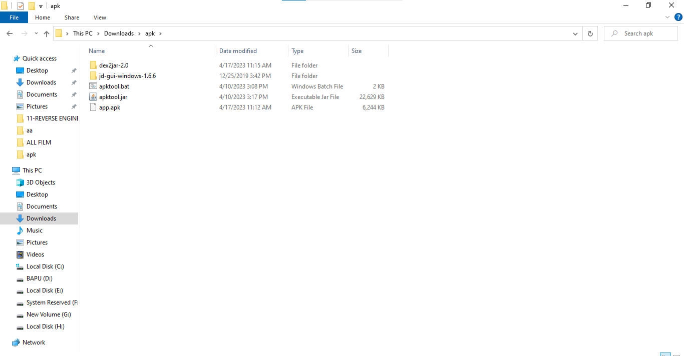
Step -1: Tools we need to perform Reverse Engineering

Slide 19
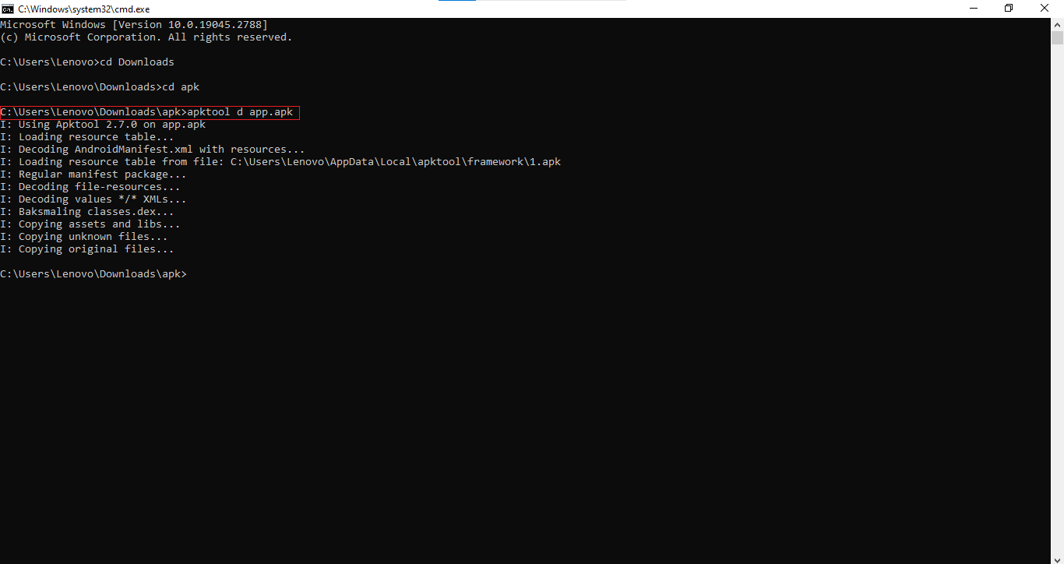
Step – 2: Here we have the apk file of Teachers_Dairy_base. Use apk decompiler to decompile it.

Slide 20
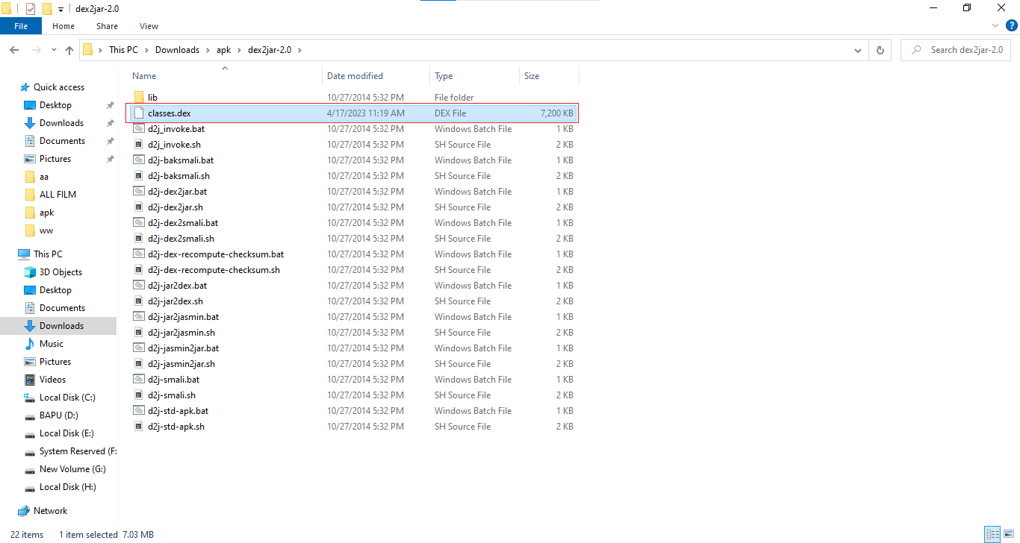
Step – 3: After decompilation in resources folder you can see a Dex file name classes. Dex. Copy it and paste it in Dex2jar folder

Slide 21
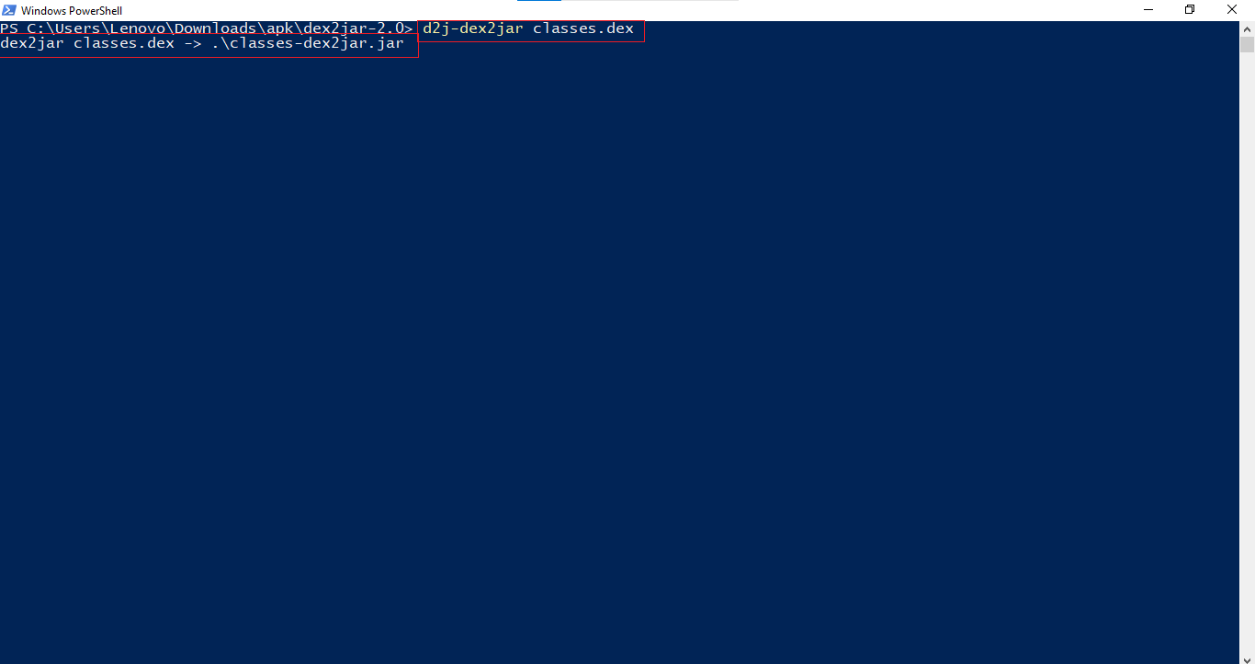
Step – 4 : Open the folder and press shift and right click then a power shell will be there write the command inside it.

Slide 22
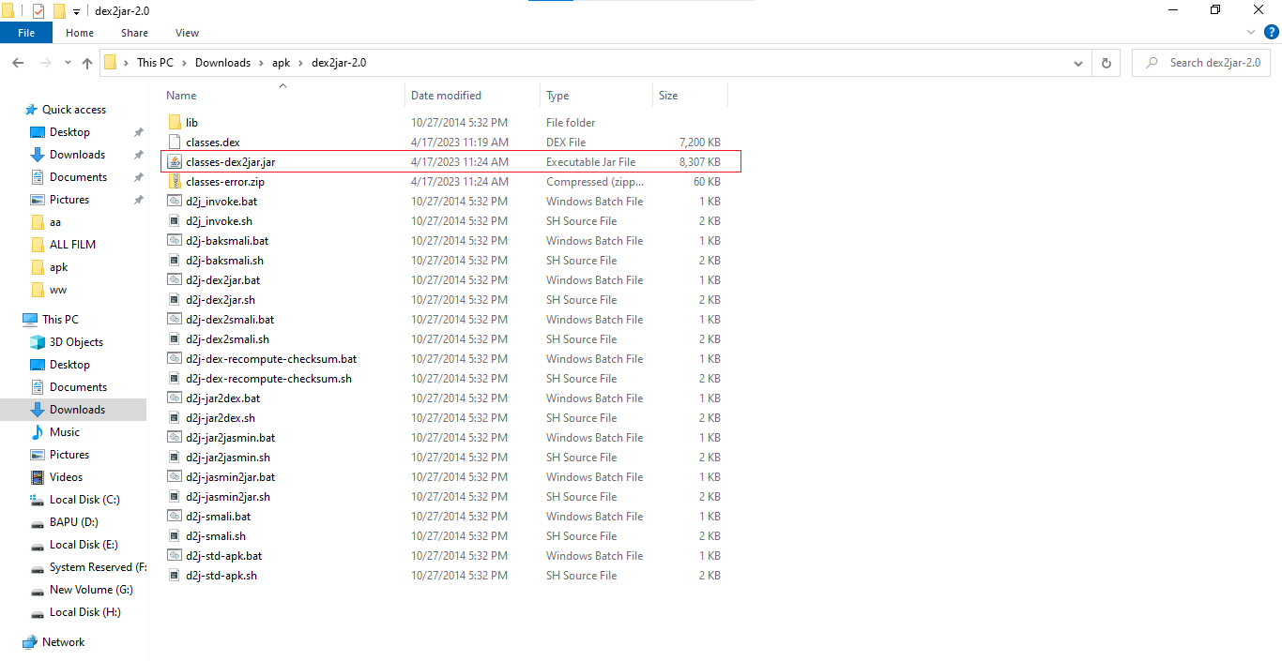
Step – 5: After that you can see a classes-dex2jar.jar file has been create

Slide 23
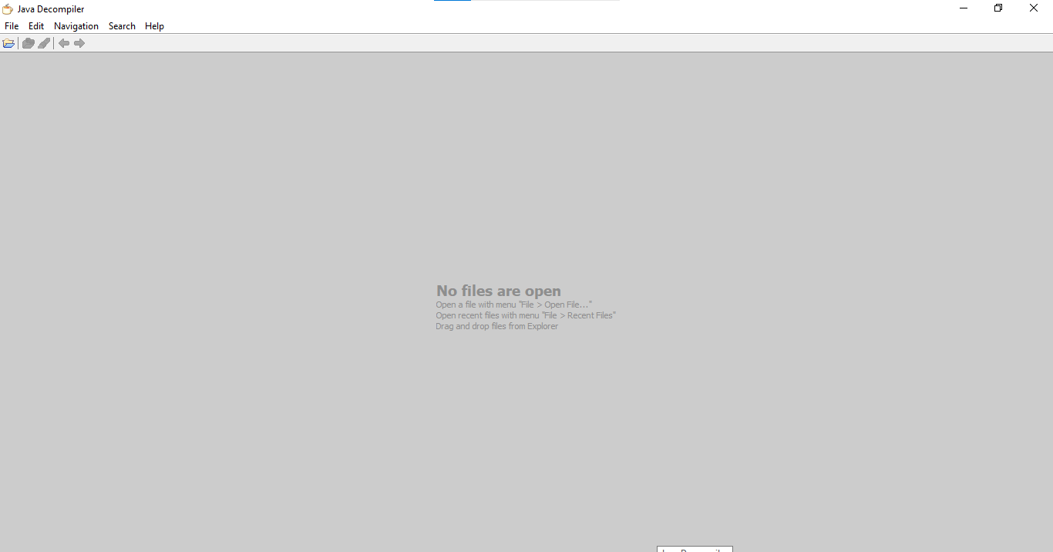
Step – 6: Then open jd-gui.

Slide 24
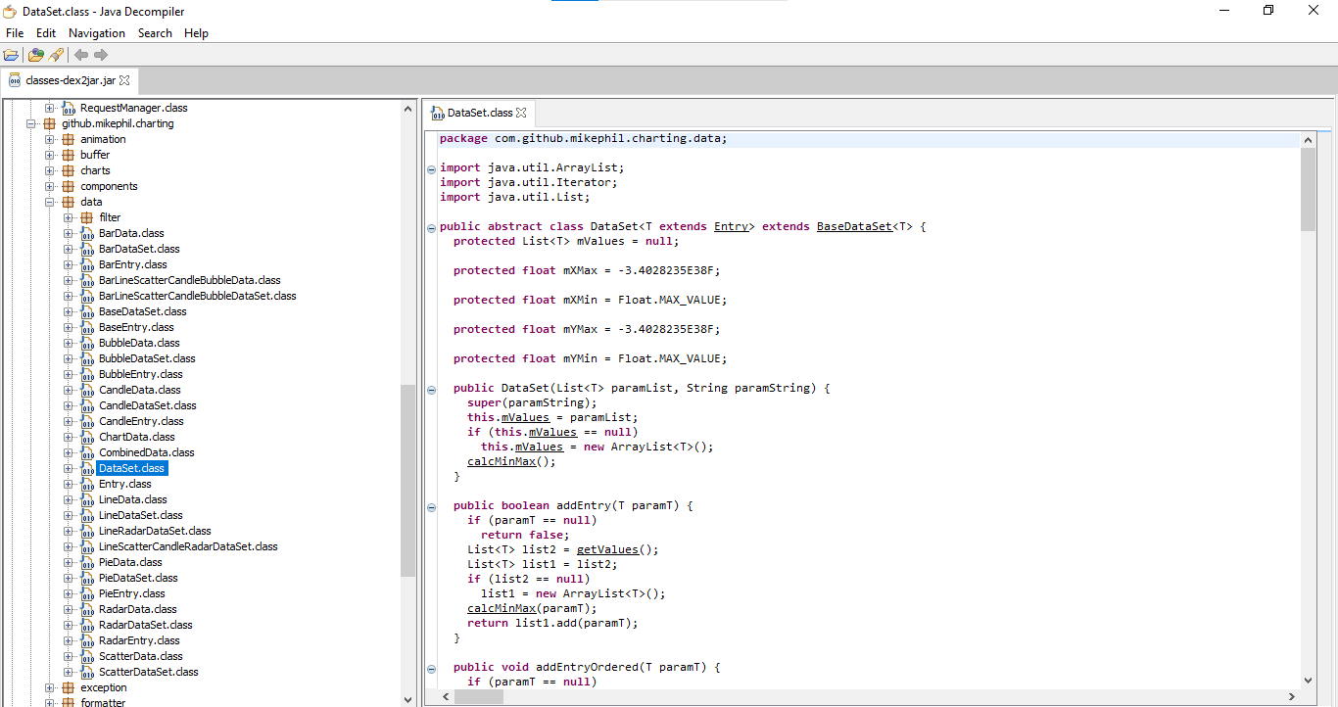
Step – 7: We can see all the file present in this app.

Slide 25
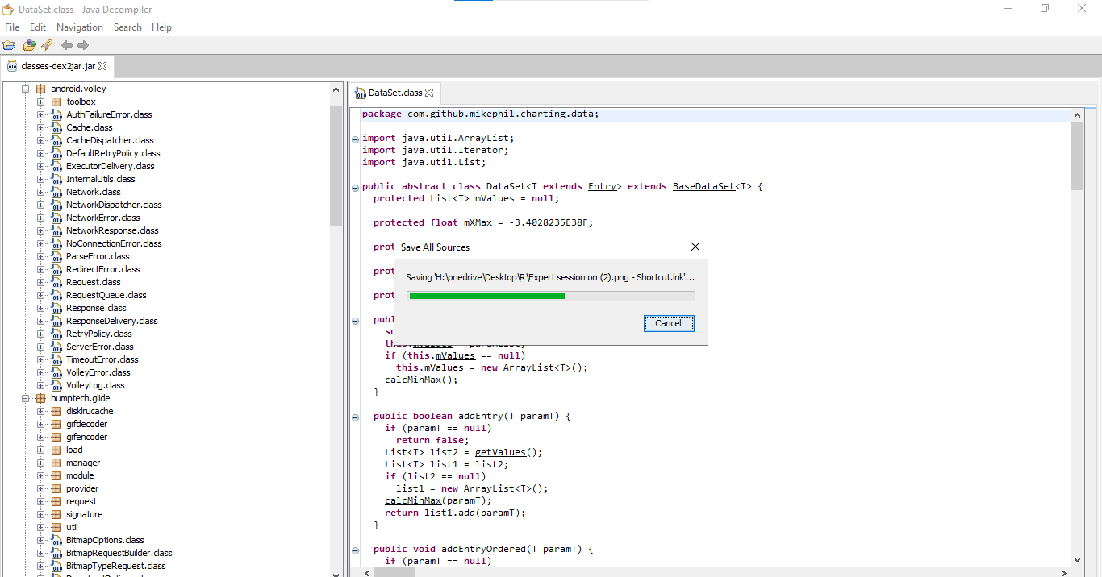
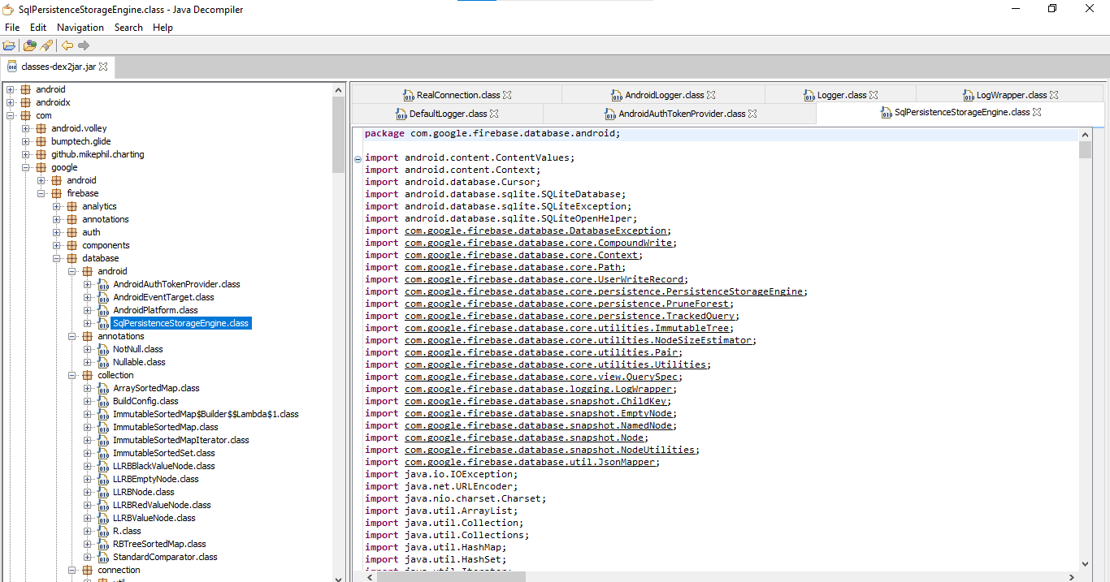

Slide 26
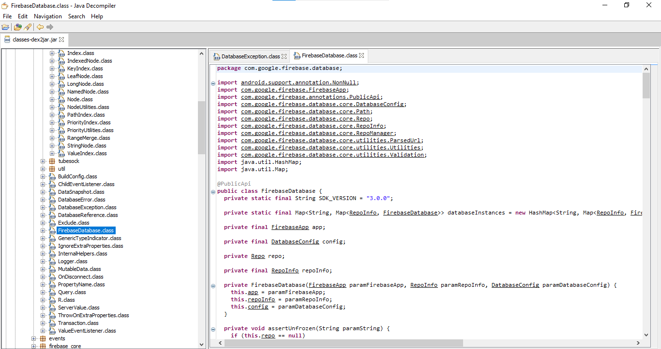

Slide 27
1.4 | Recommendation/Countermeasure
It is important to threat model your mobile app, OS, platforms, and frameworks to understand the information assets the app processes and how the APIs handle those assets. It is crucial to see how they handle the following types of features: ✓ URL caching (both request and response); ✓ Keyboard press caching; ✓ Copy/Paste buffer caching; ✓ Application backgrounding; ✓ Intermediate data ✓ Logging; ✓ HTML5 data storage; ✓ Browser cookie objects; ✓ Analytics data sent to 3rd parties.

Slide 28
2 | OTP Bypassing on Colorwiz | Risk Rating
 |  | HIGH
2.1 | Affected URLs:
https://colorwiz.in/#/login
2.2 | Impact
Unauthorized access to any User account
2.3 | PoC

Slide 29
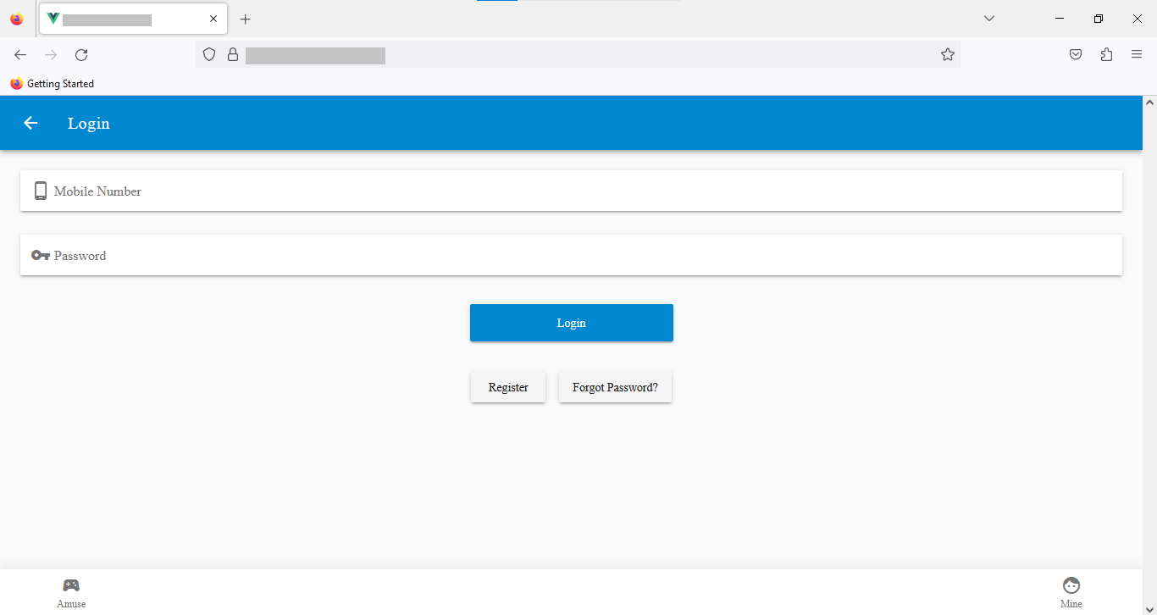
Step – 1: Visit​

Slide 30
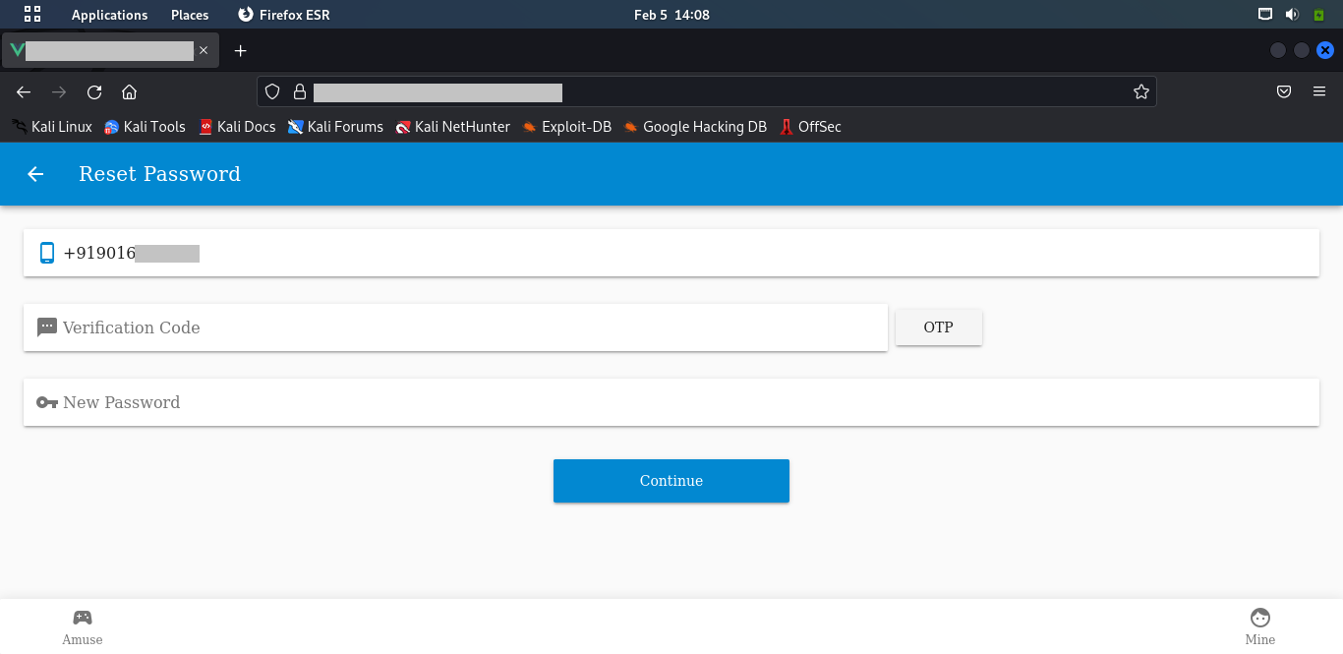
Step – 2: Enter Phone Number and Click on OTP​

Slide 31
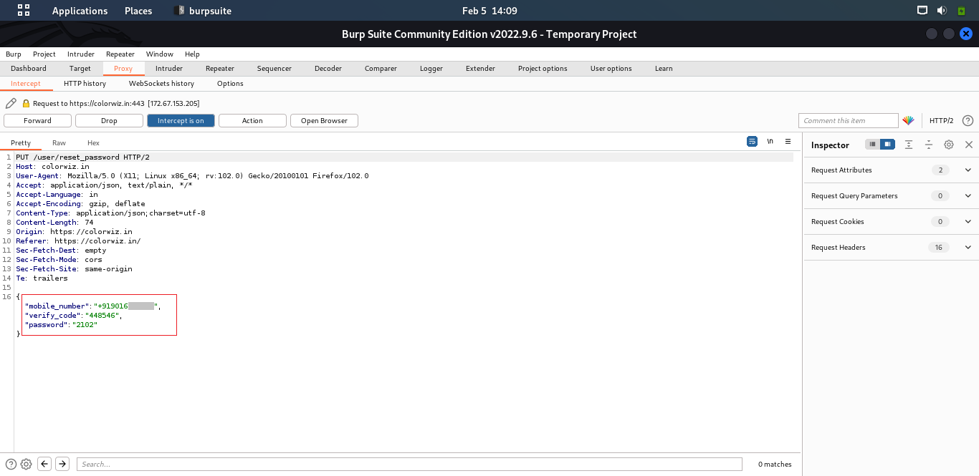
Step – 3: It Requires 6 Digit of OTP An attacker can also bypass this using response manipulation that will uses in the coming steps.
Step – 4: After this we get this response

Slide 32
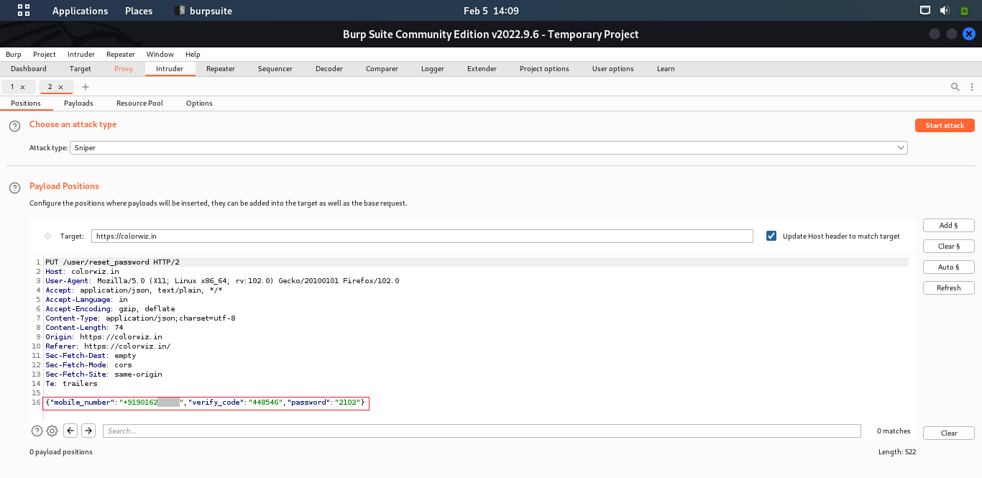
Step – 5: In this we can see that there is a parameter “verify code” in this code there is a code there we enter incorrect code

Slide 33
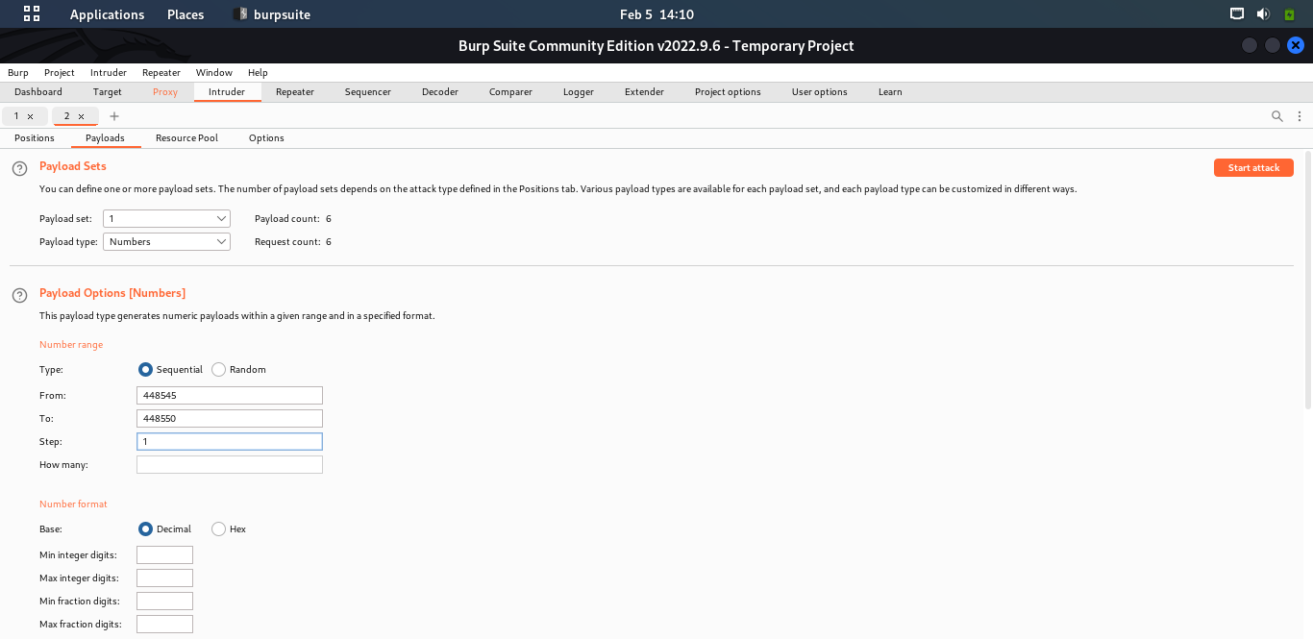
Step – 6: I send this in the Intruder and put payload of six digit and start attack

Slide 34
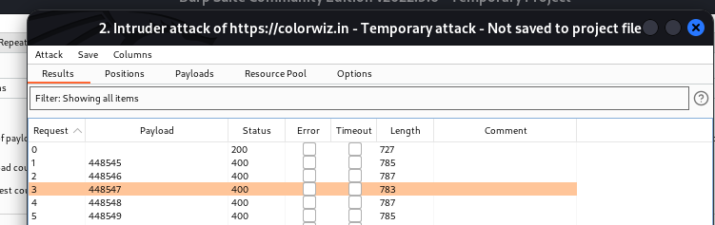
Step – 7: In this we get result there is OTP ******

Slide 35
Step – 8: I put this OTP in the parameter verify code and manipulate this and press Forward​

Slide 36
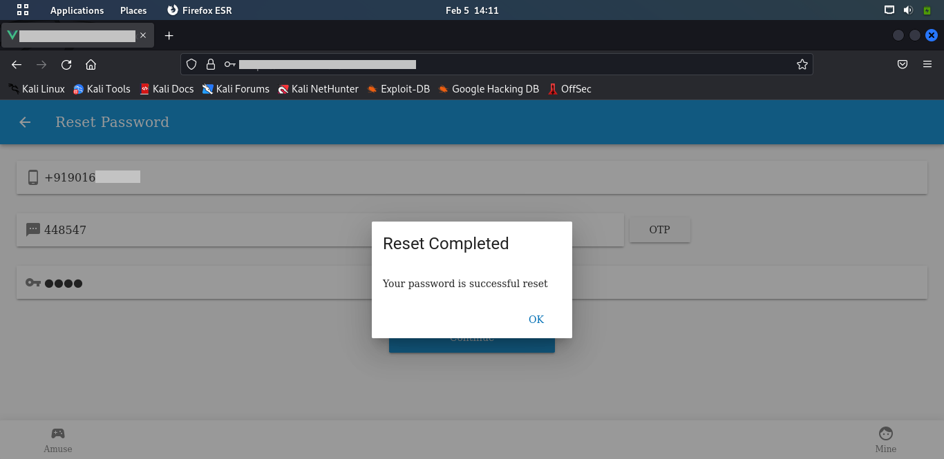
Result: Here password has been reset successful.

Slide 37
2.4 | Recommendation/Countermeasure
The most obvious way to block brute-force attacks is to simply lock out accounts after a defined number of incorrect password attempts. Account lockouts can last a specific duration, such as one hour, or the accounts could remain locked until manually unlocked by an administrator.

Slide 38
3 | SQL Injection On Science-med.com | Risk Rating
 |  | HIGH
3.1 | Affected URLs:
https://science-med.com/
3.2 | Impact
There is always risk that the user’s privacy will be compromised. • A successful attack may result in the unauthorized viewing of user lists, the deletion of entire tables and in certain cases, the attacker gaining administrative rights to a database • So, this vulnerability Is very critical !!
3.3 | PoC

Slide 39
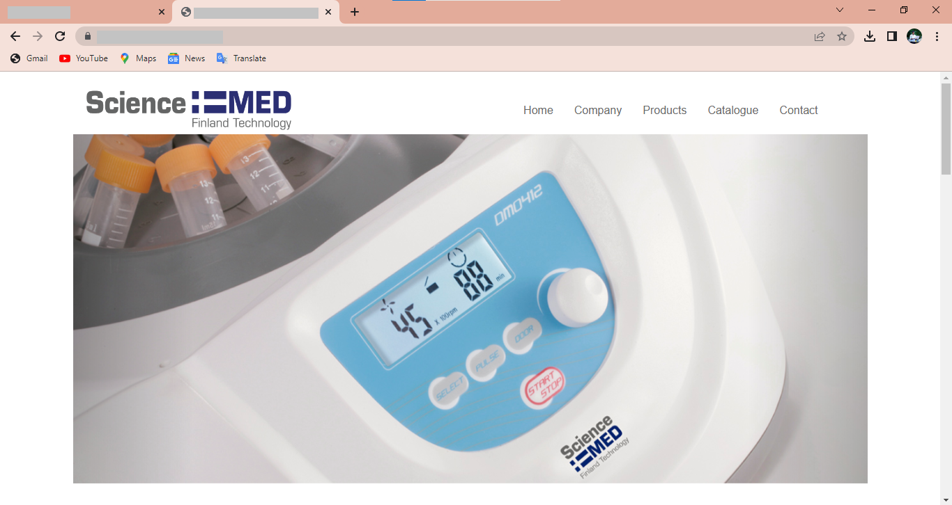
Step – 1: Visit:

Slide 40
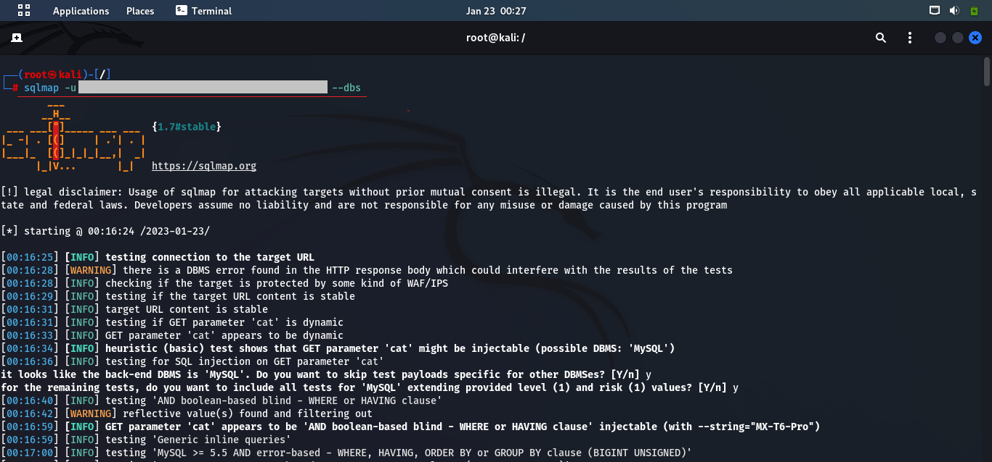
Step – 2: use SQL Map tool in kali Linux and put –u for URL and provide URL and then use –dbs. for getting the database control and use –risk 1 for increasing the risk level.

Slide 41
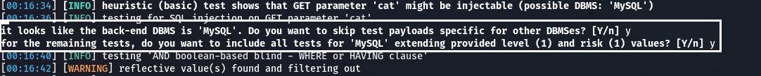
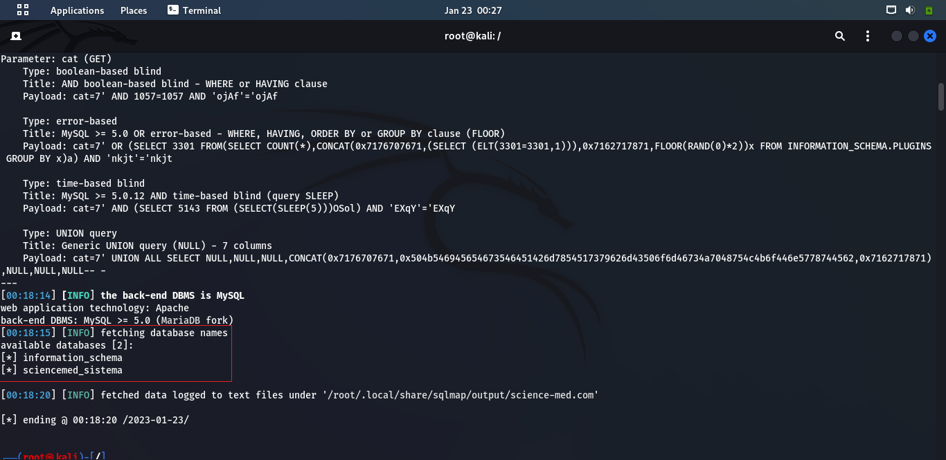
Step – 3: here you can see that we founded the backend database is MySQL It asks you want to use MySQL payload then put y for ‘yes’ and it will ask for increase the risk level and put again y for ‘yes’
Step – 4: After this we get this response and, we get the Database name.

Slide 42
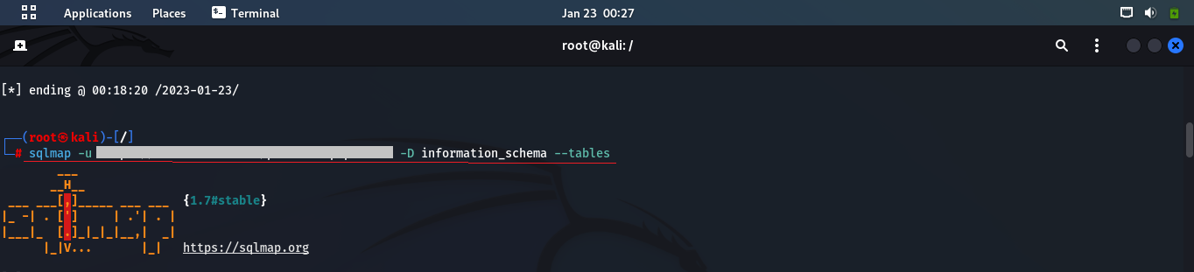
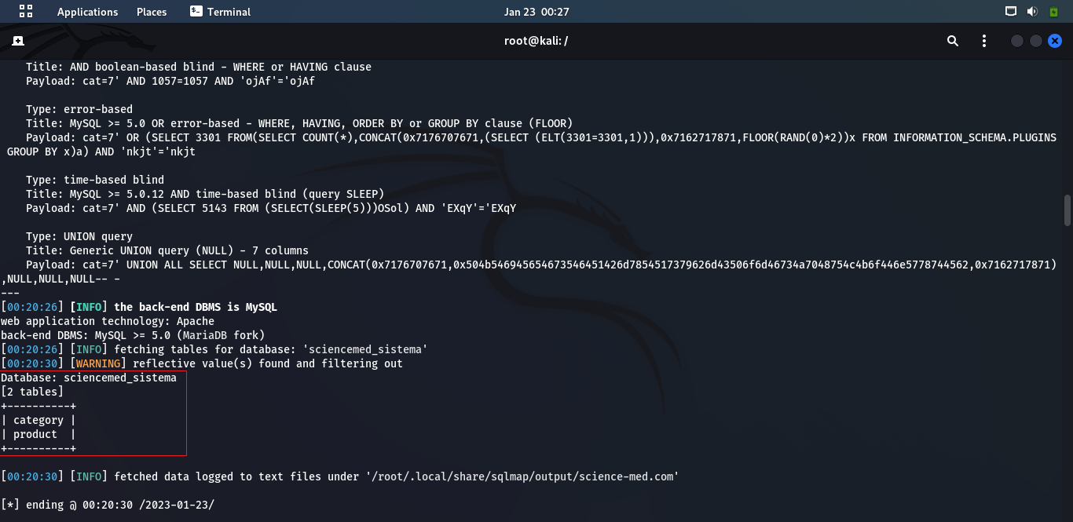
Step – 5: After getting the database name use –tables in command for retrieve all the tables name.
Step – 6: As a result, we able to retrieve all the tables name and also access the table data of database.

Slide 43
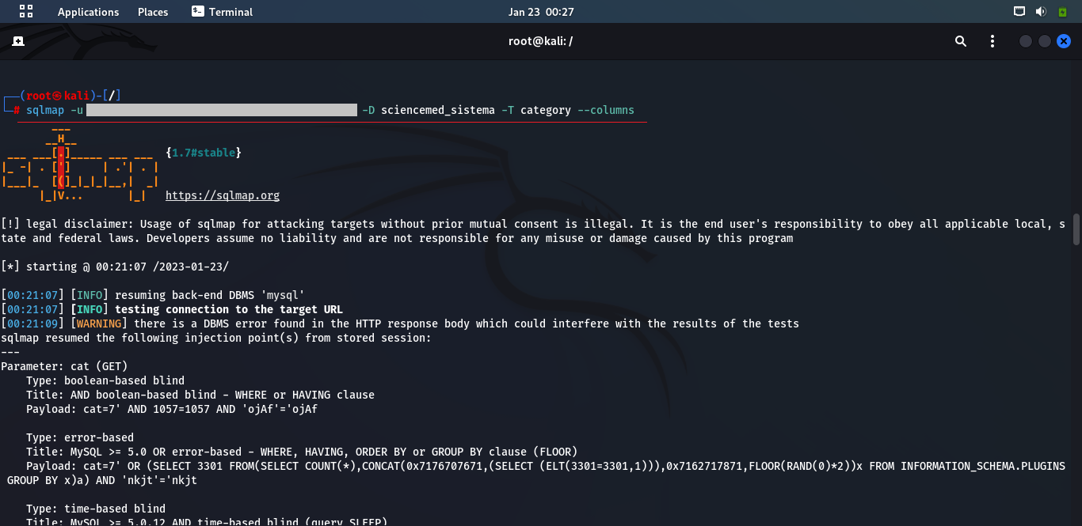
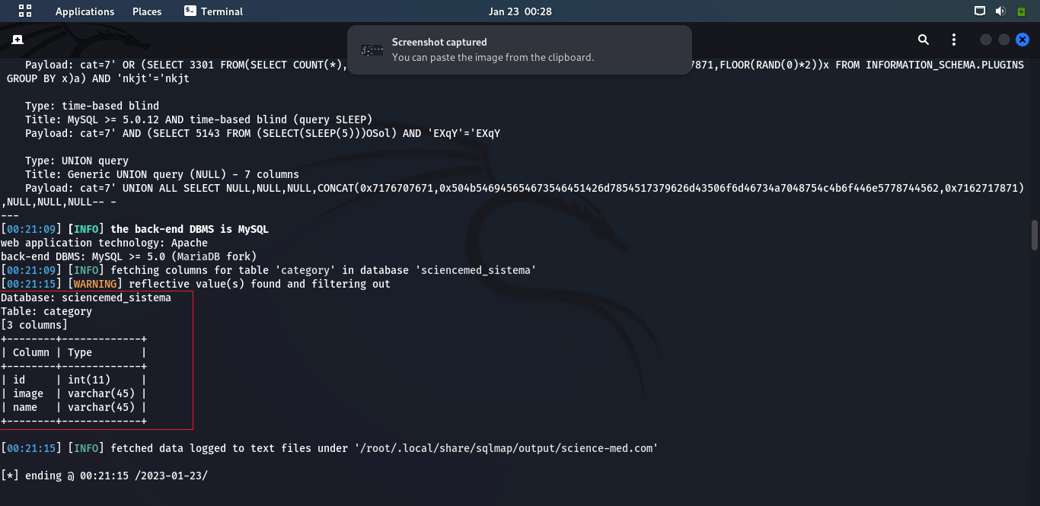
Step – 7: find out h column of those tables using – column command.
Step – 8: As a result of that –column command is like.

Slide 44
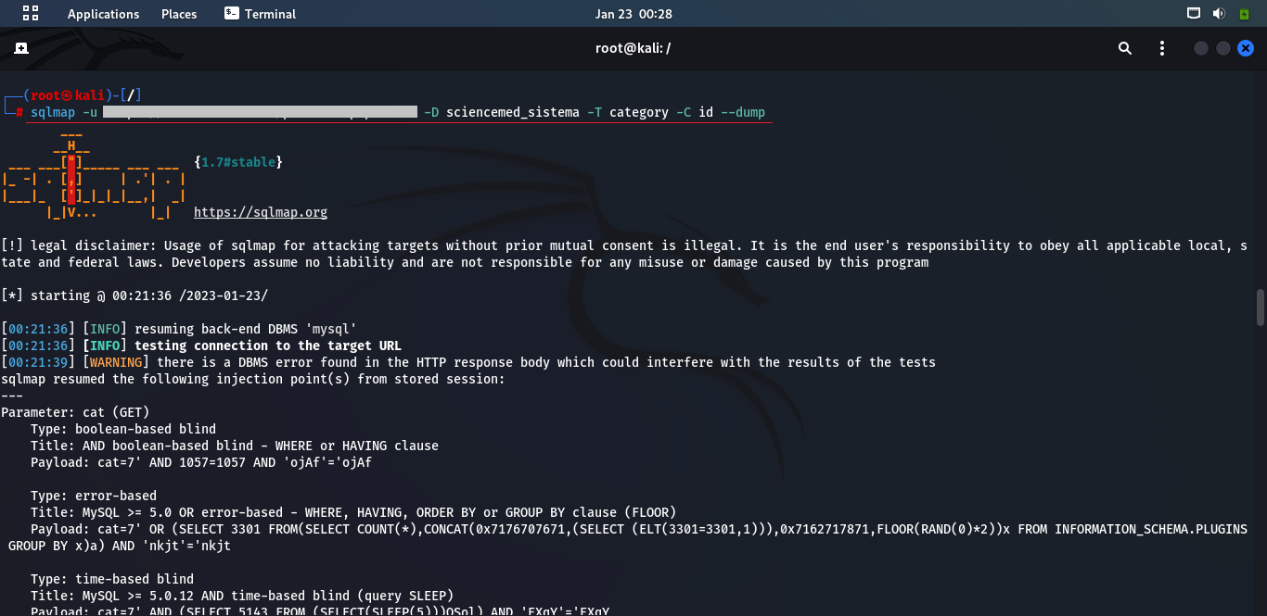
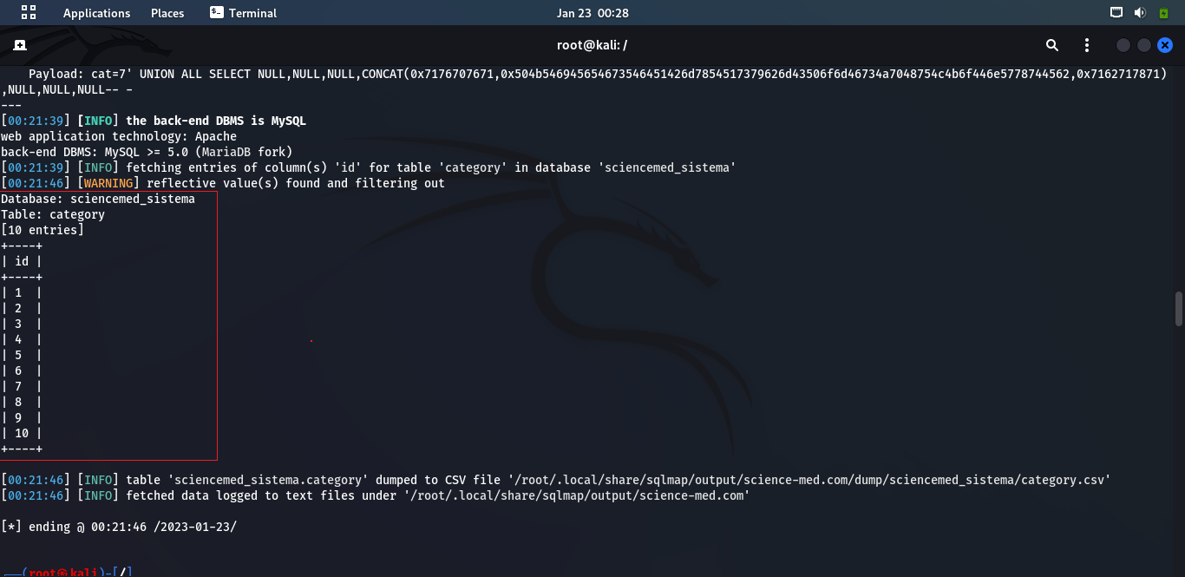
Step – 9: After getting the column of that table use – dump for retrieve the data of that table.
Result: As a result of this injection, we found the data of those table.
Id:

Slide 45
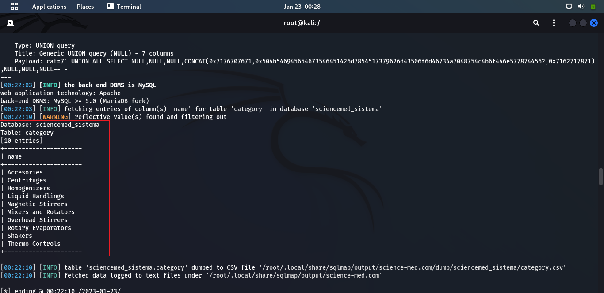
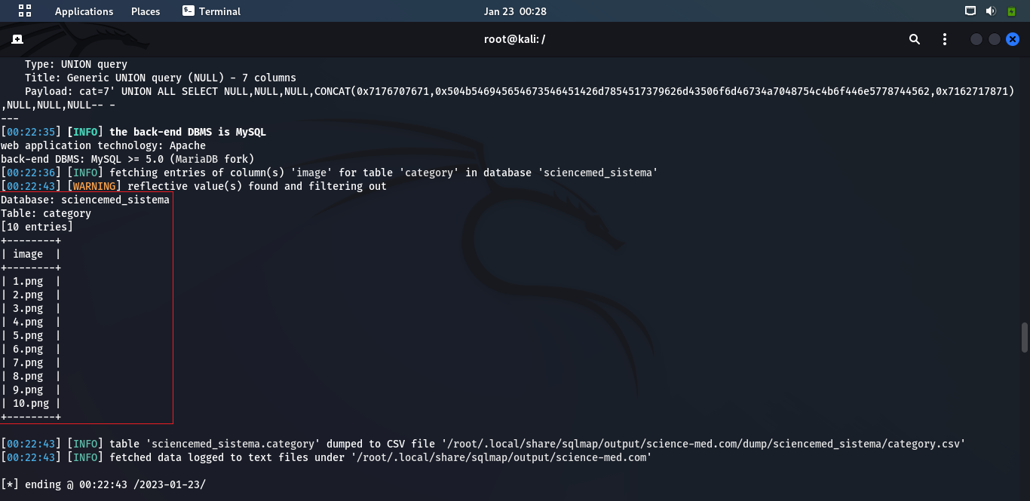
Name:
Image:

Slide 46
3.4 | Recommendation/Countermeasure
The only sure way to prevent SQL Injection attacks is input validation and parametrized queries including prepared statements. The application code should never use the input directly. The developer must sanitize all input, not only web form inputs such as login forms. They must remove potential malicious code elements such as single quotes. It is also a good idea to turn off the visibility of database errors on your production sites. Database errors can be used with SQL Injection to gain information about your database

Slide 47
4 | Cleartext Transmission of Sensitive Information | Risk Rating
 |  | HIGH
4.1 | Affected URLs:
https://www.jjhospitaltharad.com/
4.2 | Impact
Once the attacker knows the credentials of the victim, an attacker can be able to access victim’s account and could perform malicious activity.
4.3 | PoC

Slide 48
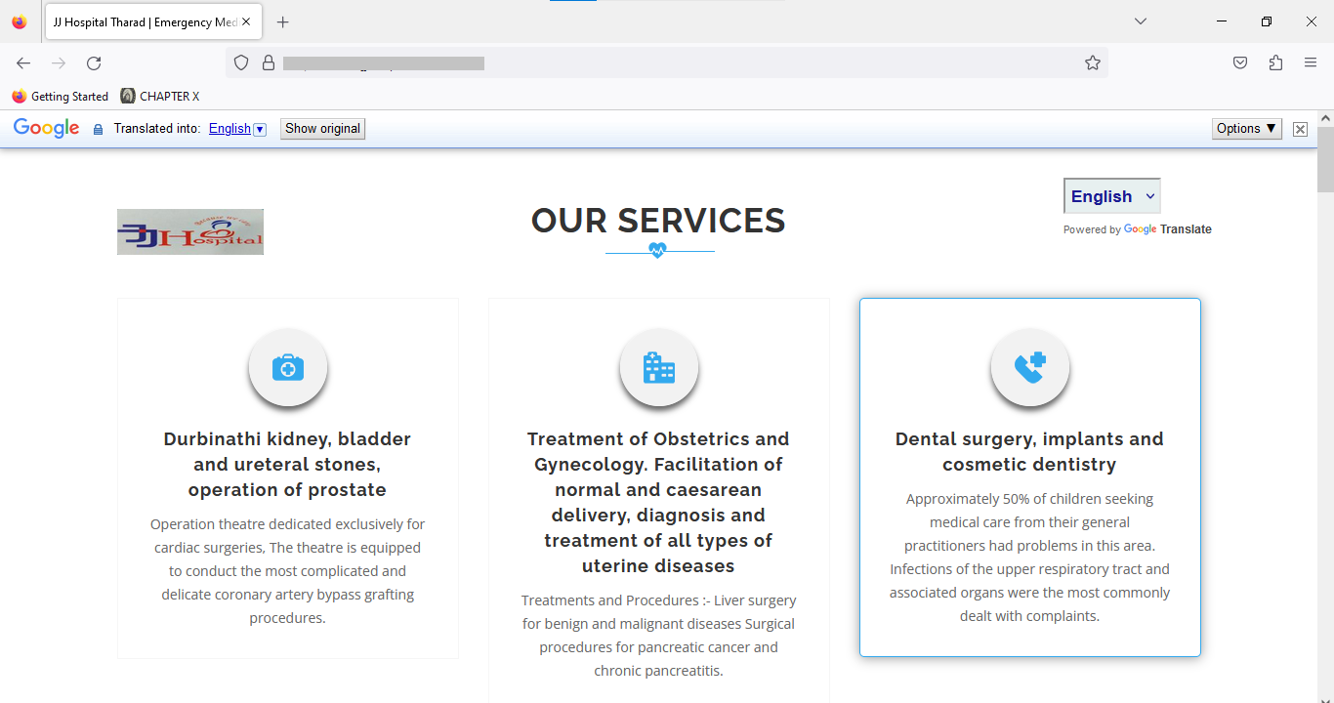
Step 1: visit:

Slide 49
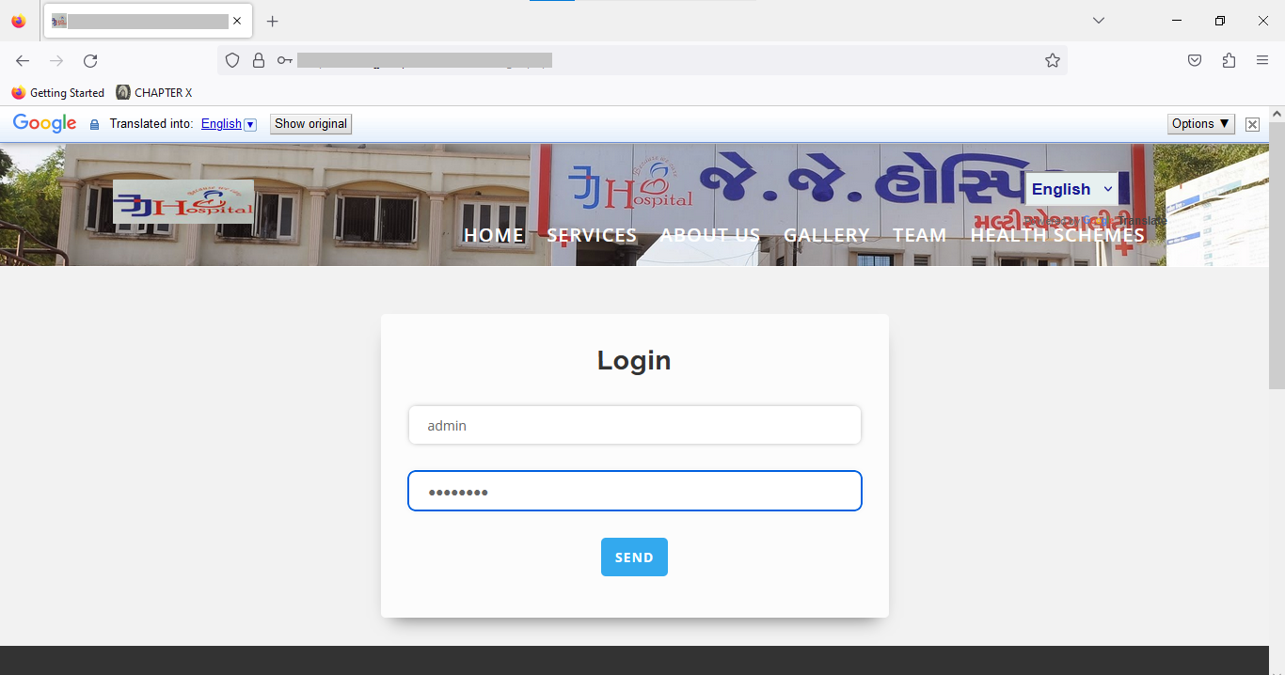
Step 2: Enter Username and Password:

Slide 50
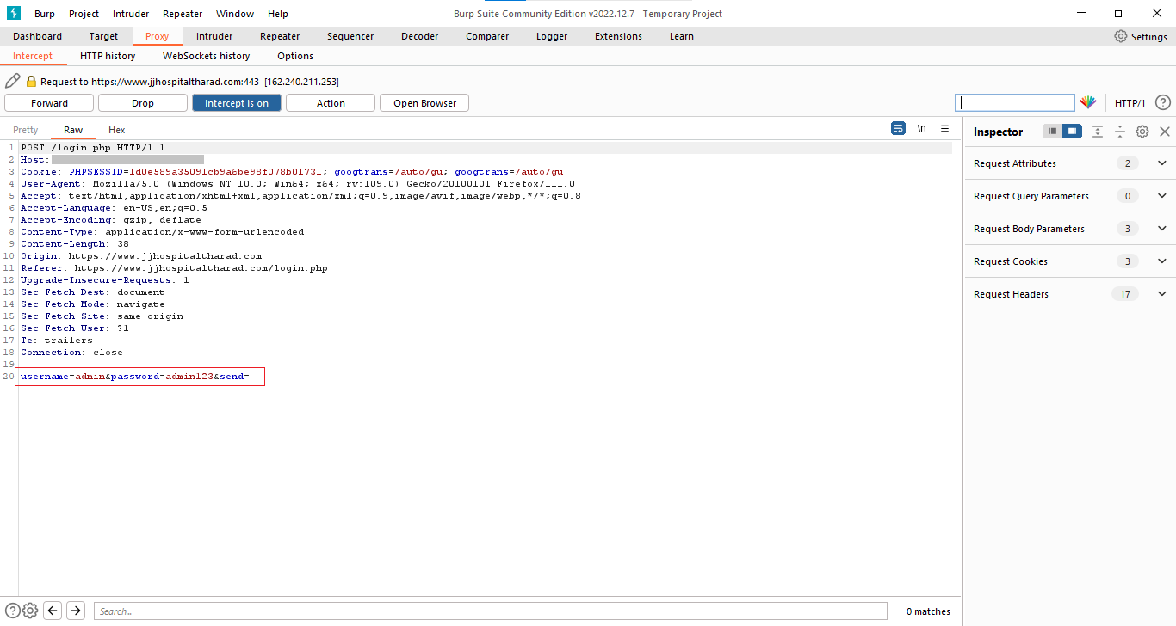
Step – 3: Now using burp suite we can see the username and password clearly.

Slide 51
4.4 | Recommendation/Countermeasure
It is recommended to use asymmetric encryption to encrypt the sensitive parameters to prevent from being modified or exposed in plain text.

Slide 52
5 | No Rate Limit on Current Password Field | Risk Rating
 |  | HIGH
5.1 | Affected URLs:
https://www.jjhospitaltharad.com/
5.2 | Impact
There is no rate limit enabled for the "Old Password" field on changing password on your website. A malicious minded user can continually try to brute force an account password. If a user forgets to logout an account in some public computer, then the attacker is able to know the correct password, and also able to change the password to a new one by inputting a large number of payloads.
5.3 | PoC

Slide 53
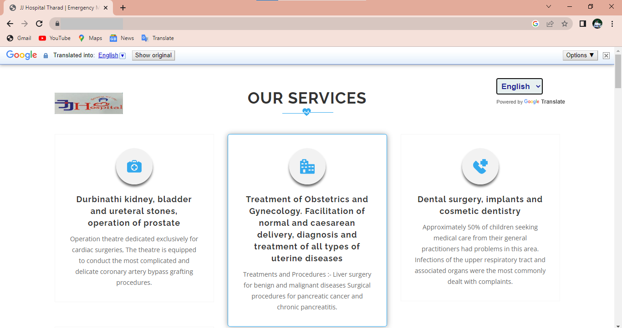
Step 1: visit:

Slide 54
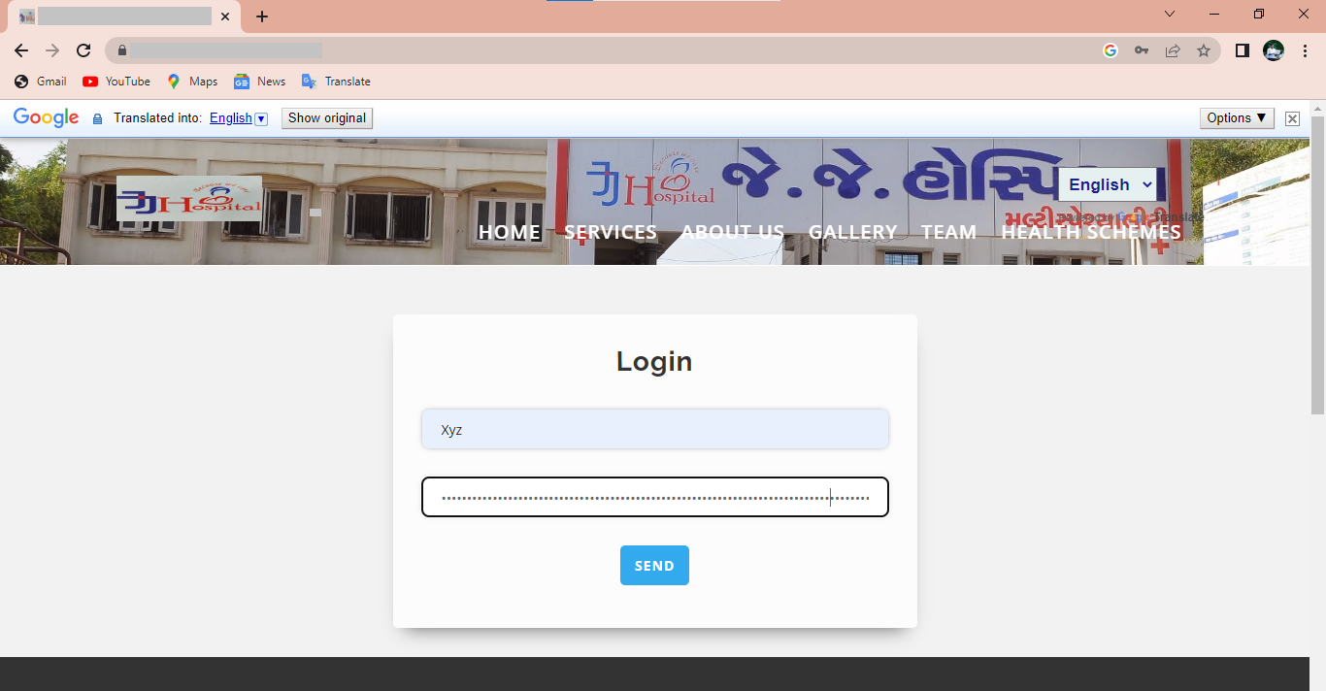

Slide 55
5.4 | Recommendation/Countermeasure
Monitoring API activity against your rate limit. Catching errors caused by rate limiting. Reducing the number of requests. Extra precautions are taken with login, otp, vouchers etc.

Slide 56
6 | HTML Injection on kubbair.com | Risk Rating
 |  | MEDIUM
6.1 | Affected URLs:
https://kubbair.com/
6.2 | Impact
HTML Injection allow an attacker to modify the page. •Using HTML Form, it can steal another person's identity. •Attacker crafts malicious links, including his injected HTML content, and sends it to a user via email. •At the end it can be a very serious vulnerability.
6.3 | PoC

Slide 57
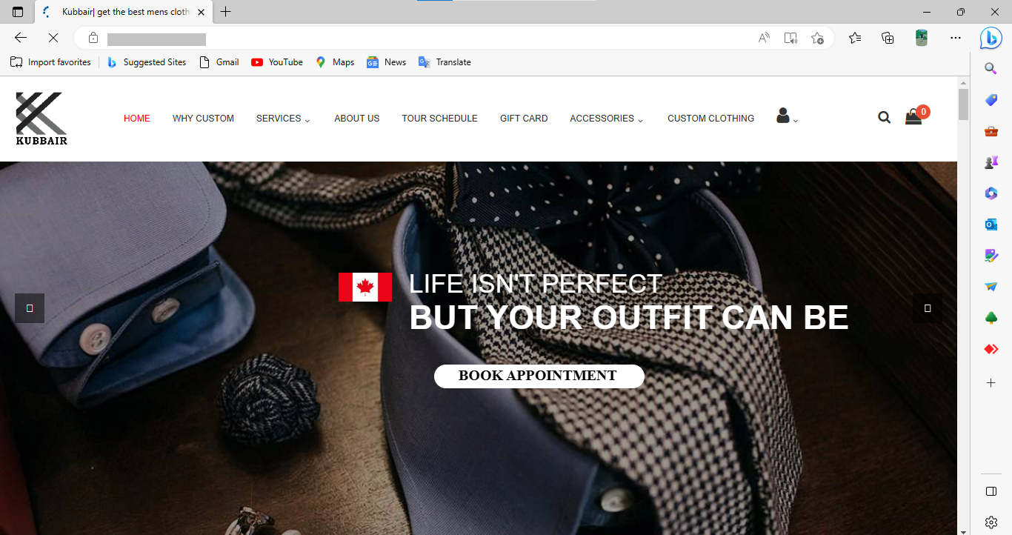
Step – 1: Visit:

Slide 58
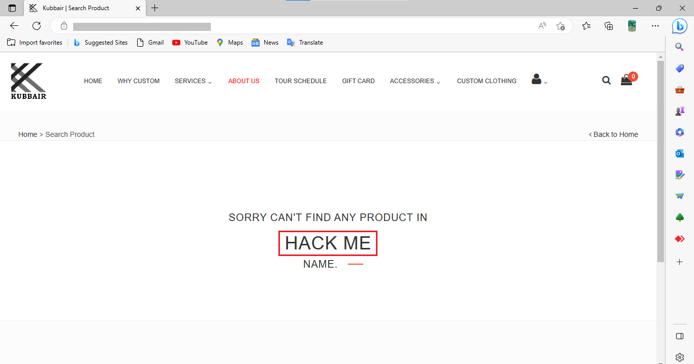
Step – 2: Try To inject HTML code in to the id parameter. Here we use <a> tag for referring an URL .
Step – 3: Here whenever anyone click on the HACK ME, he will be redirect to the google.com Because In code we inject<a href=https://google.com>HACK ME</a>

Slide 59
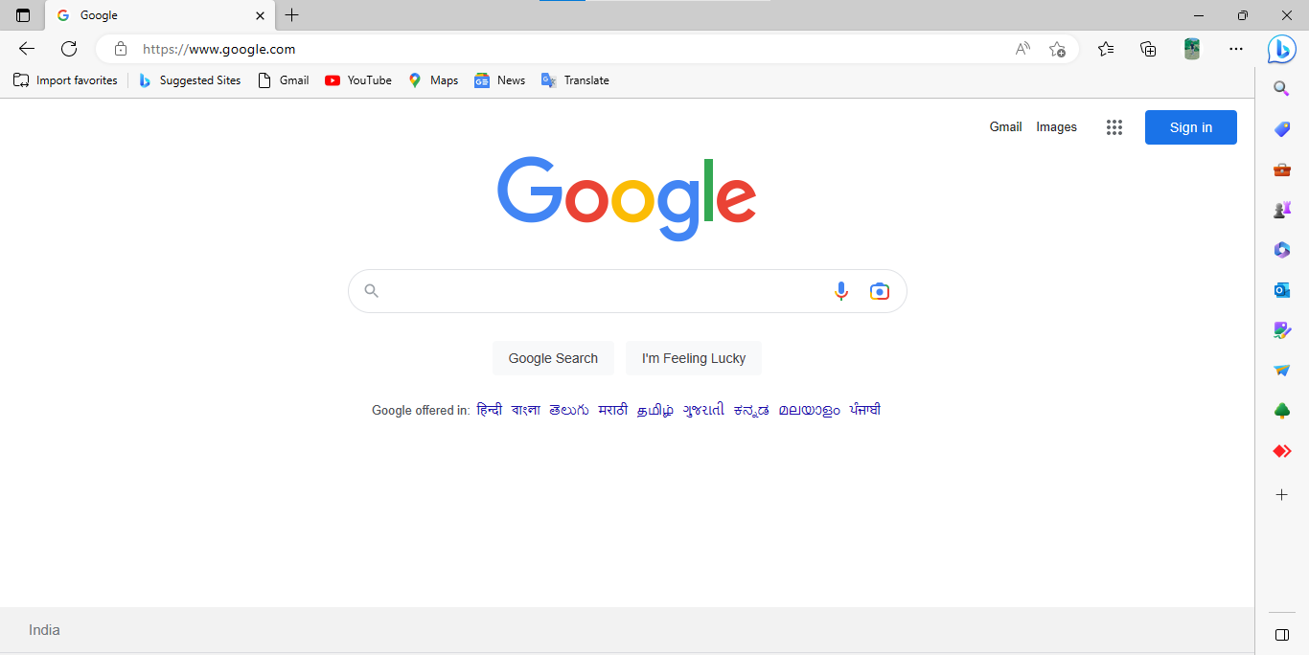
Result: As a result, when anyone click on this HACK ME He will be redirect to the google.com.
If attacker provide the URL of his own site and he can steal the data of users who fill those form.

Slide 60
6.4 | Recommendation/Countermeasure
Use regular-expressions and filter the character like <, >, /, //, \\, \, etc. so the tag like <a> it cannot be work. Use Post method mainly to hide the URL and the vulnerable parameter from attacker. Use the proper sanitizer the input fields. Ex. You can use mysqli_real_escape_string function at database side.

Slide 61
7 | XSS (Cross–site Scripting) On Webloadmpstore.com | Risk Rating
 |  | MEDIUM
7.1 | Affected URLs:
http://webloadmpstore.com/
7.2 | Impact
XSS stands for Cross-Site Scripting and it is a web-based vulnerability in which an attacker can inject malicious scripts in the application. • Code injected into a vulnerable application can exfiltrate data or install malware on the user’s machine. • Attacker can get the cookie and Attackers can masquerade as authorized users via session cookies, allowing them to perform any action allowed by the user account. • XSS can also impact a business’s reputation. An attacker can deface a corporate website by altering its content, thereby damaging the company’s image, or spreading misinformation
7.3 | PoC

Slide 62
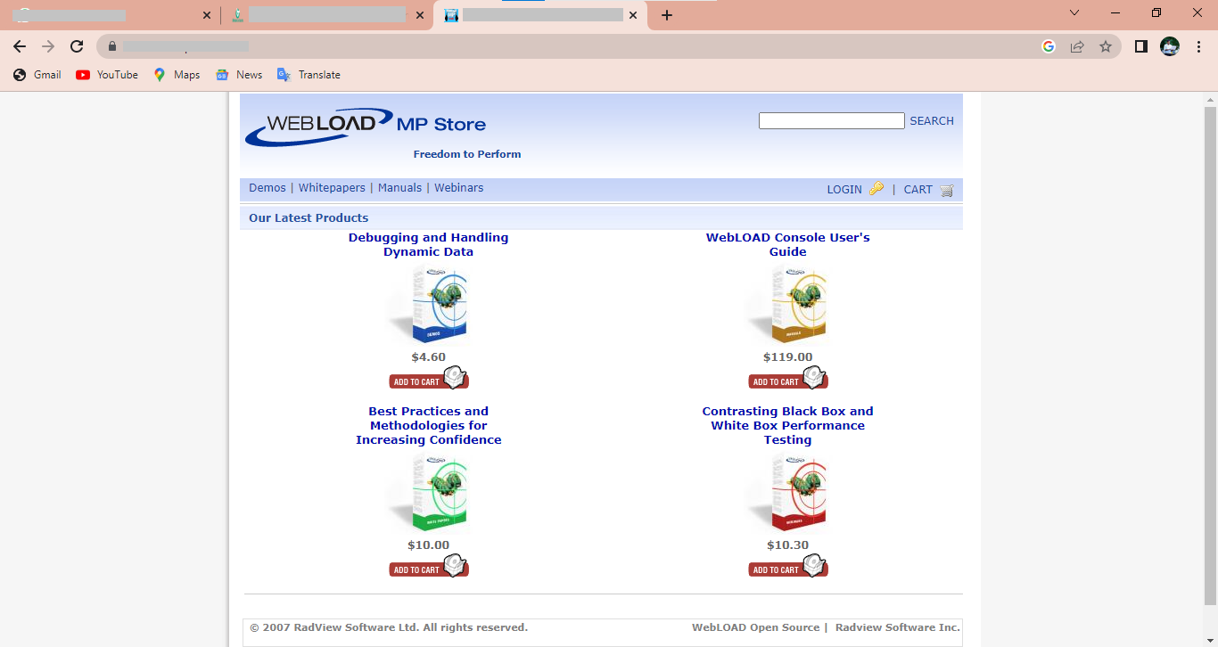
Step – 1: Visit:

Slide 63
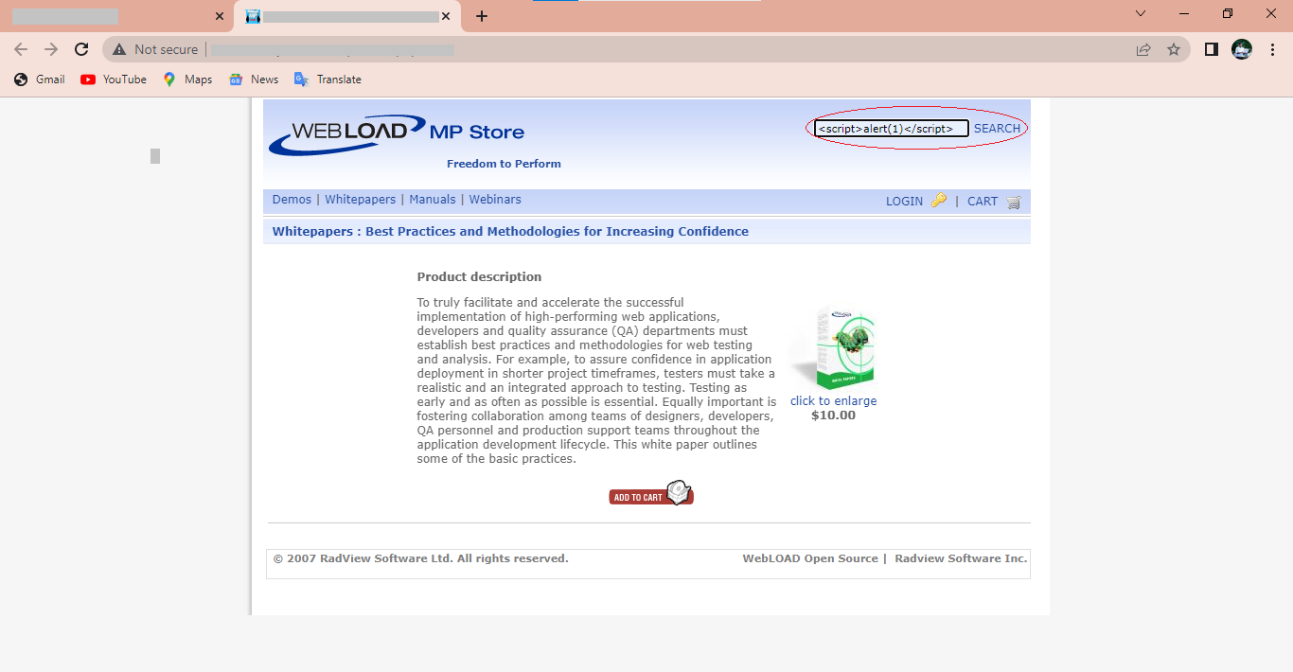
Step – 2 :- Try To inject JavaScript in this URL in the id parameter like <script>alert(1)</script>

Slide 64
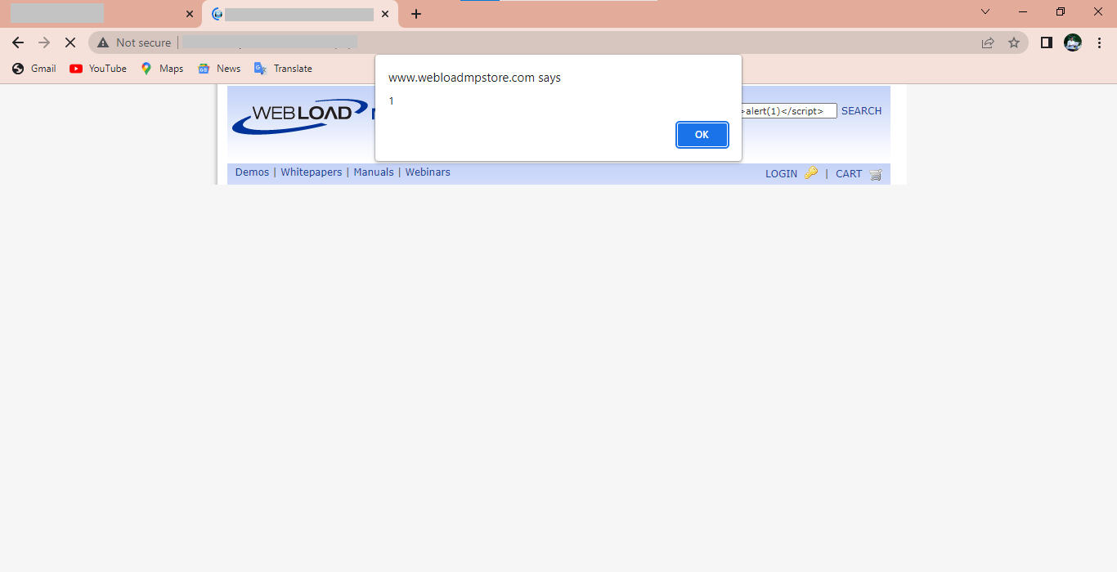
Step – 3: - Result: After this we get a pop up and with the content is (1) Which one I injected in the parameter. here we can also modify and use document. Cookie for etc. the cookie of the user, document. Location for getting location, etc.

Slide 65
7.4 | Recommendation/Countermeasure
Filter input on arrival. At the point where user input is received, filter as strictly as possible based on what is expected or valid input. Encode data on output. At the point where user-controllable data is output in HTTP responses, encode the output to prevent it from being interpreted as active content. Depending on the output context, this might require applying combinations of HTML, URL, JavaScript, and CSS encoding. Use appropriate response headers. To prevent XSS in HTTP responses that are not intended to contain any HTML or JavaScript, you can use the Content-Type and X-Content-Type-Options headers to ensure that browsers interpret the responses in the way you intend. Content Security Policy. As a last line of defense, you can use Content Security Policy (CSP) to reduce the severity of any XSS vulnerabilities that still occur.

Slide 66
8 | Click Jacking on Fiewin.com | Risk Rating
 |  | MEDIUM
8.1 | Affected URLs:
http://fiewin.com/#/
8.2 | Impact
Clickjacking is a vulnerability through which users are tricked to click some buttons or UI elements of the parent page, but they are clicking something in the vulnerable web application, because that is being hidden behind the UI of the parent page. The User assumes that they are entering their information into usual form but they are entering it in fields, Hackers will target passwords, credit card numbers and any other valuable data they can exploit.
8.3 | PoC

Slide 67
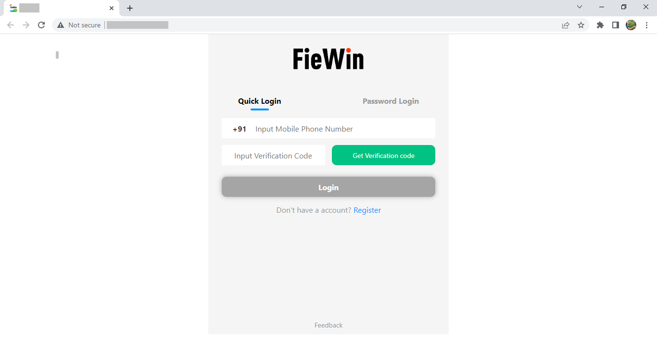
Step – 1: Visit:

Slide 68
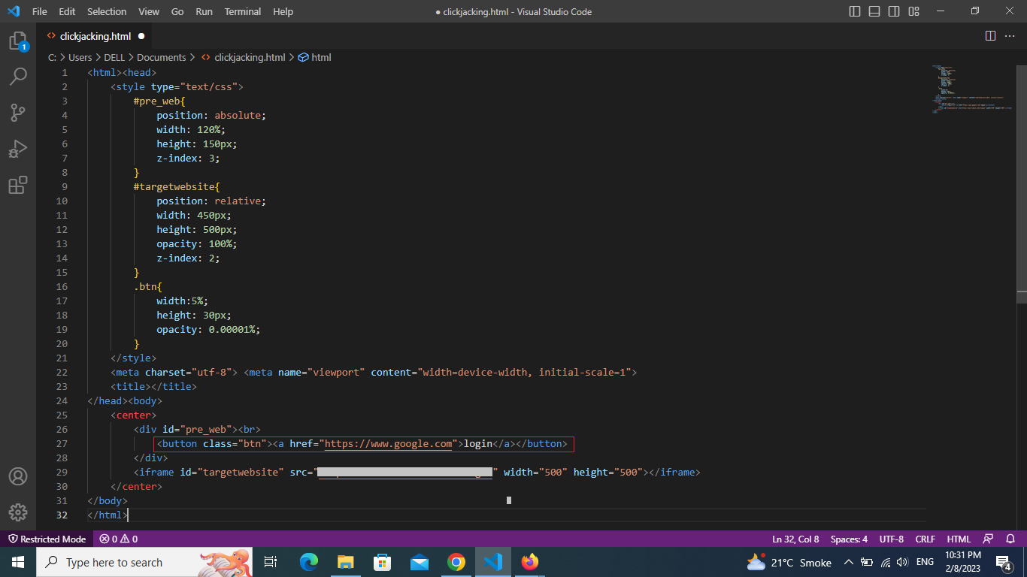
Step – 2: Here enter the script like this

Slide 69
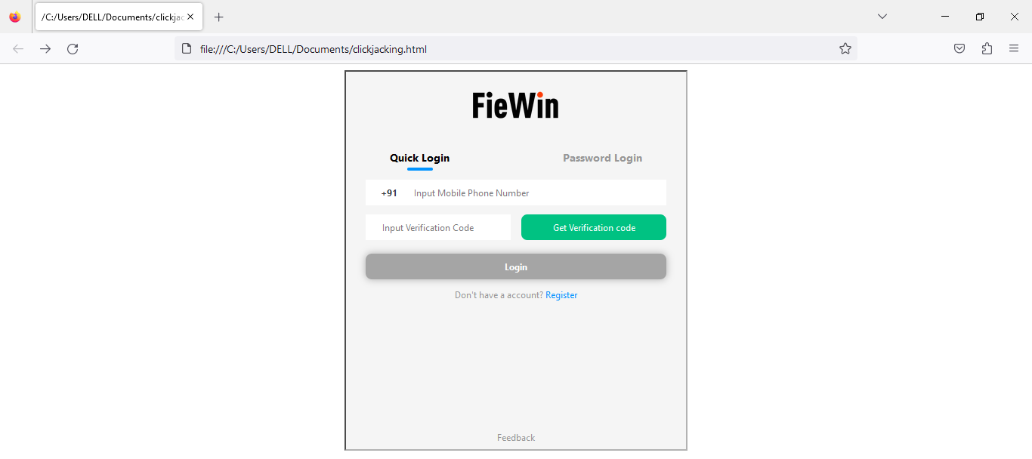
Step – 3: after This script run it its looks like this because it is i-frame

Slide 70
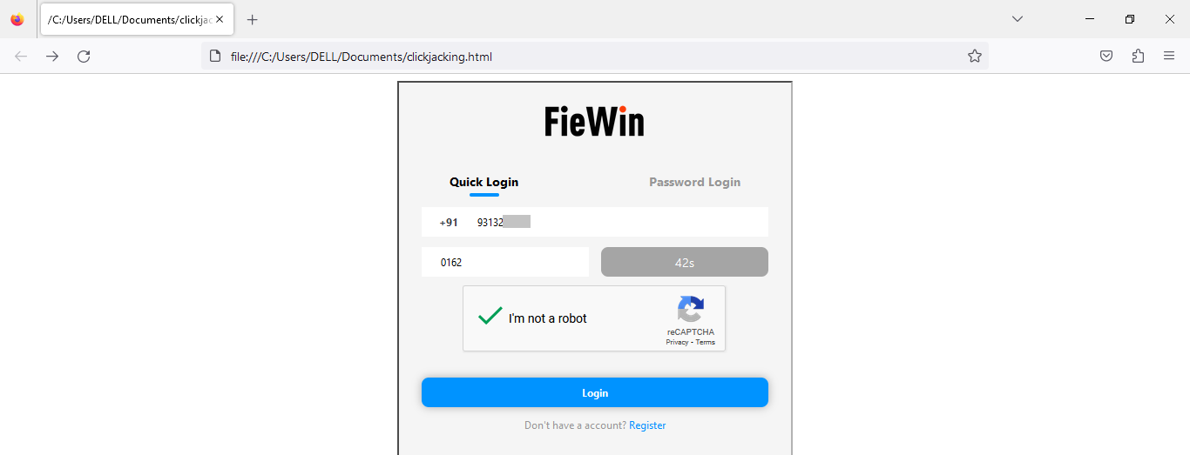
Step – 4: Here I click on Login after fill the form...

Slide 71
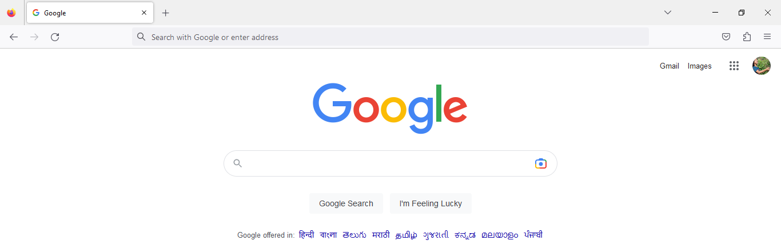
Step – 5: after clicking on login, it will be redirect to the google because I written this in this script.

Slide 72
8.4 | Recommendation/Countermeasure
Properly setting authentication cookies with Same Site = Strict, unless they explicitly need None.

Slide 73
9 | Directory Traversal | Risk Rating
 |  | MEDIUM
9.1 | Affected URLs:
https://www.zse.co./
9.2 | Impact
An attacker can leverage a directory traversal vulnerability in the system to step out of the root directory, allowing them to access other parts of the file system to view restricted files and gather more information required to further compromise the system.
9.3 | PoC

Slide 74
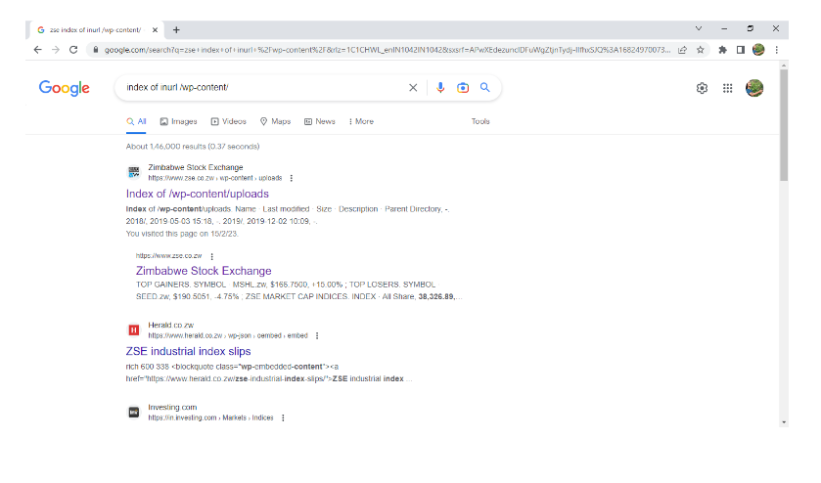
Step 1: visit:

Slide 75
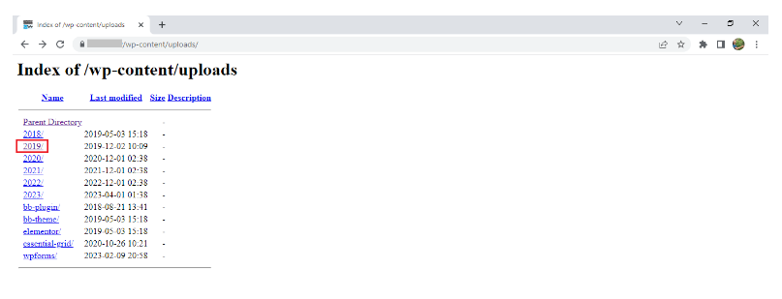
Step 2 : Click any one directory. On clicking we can access all sub-directories of about directories.

Slide 76
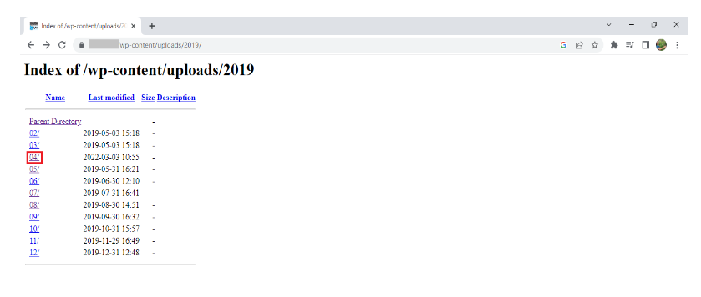
Step 3 : Here you can see the sub directories of about directory. You can select any one directory from the following. Here we have selected 04 directory.

Slide 77
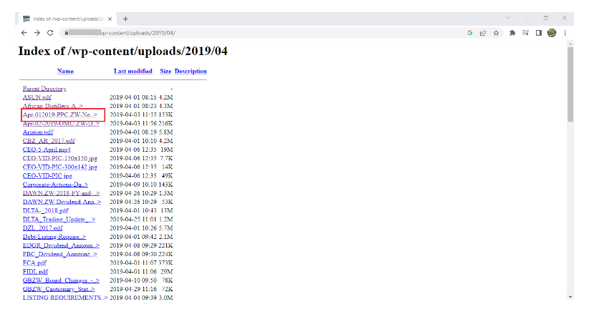
Step 4 : Here you can see the all files like pdf or images which are in the 04 directory. You can open any of the given file. We have clicked on
2019-04-apr-012019-PPC.ZW- Notice-of-directors-dealings.pdf.

Slide 78

Step 5 : As a result, we can see the pdf.

Slide 79
9.4 | Recommendation/Countermeasure
The most effective way to prevent file path traversal vulnerabilities is to avoid passing user- supplied input to filesystem APIs altogether. Many application functions that do this can be rewritten to deliver the same behavior in a safer way. If it is considered unavoidable to pass user-supplied input to filesystem APIs, then two layers of defense should be used together to prevent attacks: The application should validate the user input before processing it. Ideally, the validation should compare against a whitelist of permitted values. If that is not possible for the required functionality, then the validation should verify that the input contains only permitted content, such as purely alphanumeric characters. After validating the supplied input, the application should append the input to the base directory and use a platform filesystem API to canonicalize the path. It should verify that the canonicalized path starts with the expected base directory.

Slide 80
10 | No Rate limiting on Admin Login page | Risk Rating
 |  | MEDIUM
10.1 | Affected URLs:
https://www.jjhospitaltharad.com/login.php
10.2 | Impact
The impact of this vulnerability is high, A malicious minded user can continually try to brute force an account password. If user forget to logout account in some public computer, then attacker is able to know the correct password, and also able to change the password to new one by inputting large number of payloads.
10.3 | PoC

Slide 81

Step 1: visit

Slide 82

Step 2 : Here, we have write username and password and send.

Slide 83

Step 3 : In the burp suite , we can see username and password of whatever we can send.

Slide 84

Step 4 : Now , here we click on right and send to intruder.

Slide 85

Step 5 : Here, firstly we have to clear and add the username and password and
go to the payloads.

Slide 86

Step 6 : Here, we add some username and password and click on start attack.

Slide 87

Result :

Slide 88
10.4 | Recommendation/Countermeasure
It is recommended to limit the rate for current password field. Add A ReCAPTCHA & Sort of Something Which Requires Manual Human Interaction to Proceed Like You Can Add Captcha Like 2+2=___ so that it cannot be brute forced and you also can have a limit at the backend for particular number up to 5 times a day user can request Forget Password Email or Link something like that will prevent you from someone exploiting this vulnerability.

Slide 89
11 | Dos Attack | Risk Rating
 |  | MEDIUM
11.1 | Affected URLs:
http://www.embryohotel.com/
11.2 | Impact
Genuine users are not able to access resources, so may not be able to find the information or carry out the actions they need. Businesses may not be able to carry out time critical actions. They may suffer reputational damage. Customers may choose to use a competitor.
11.3 | Poc

Slide 90

Step 1: Visit:

Slide 91

Step 2: Here, we used command prompt and pinging the website and we found IP of the website.

Slide 92

Step 3: Here, we used kali Linux and install tool that is hping3 tool for
dos( denial of service) attack.

Slide 93


Slide 94

Result:

Slide 95
11.4 | Recommendation/Countermeasure
Perform a network vulnerability audit. In order to properly defend your network, you have to understand its weaknesses. Secure your infrastructure. Reduce the attack surface. Create a DoS response plan. Know the warning signs.

Slide 96
12 | CSS Injection | Risk Rating
 |  | LOW
12.1 | Affected URLs:
https://kubbair.com/
12.2 | Impact
an attacker is able to execute arbitrary server-side code.
12.2 | PoC

Slide 97

Step - 1: Visit:

Slide 98

Step - 2: Here we have injected a CSS code in this website. <body style="background-color: pink; opacity:50%; padding: top 50px;"></body>

Slide 99

Step - 3: As we can see the color has been changed to Pink same as the code we have entered.
Result: Anyone can change any image or description etc.

Slide 100
12.4 | Recommendation/Countermeasure
Sanitization based on context Using a strong Content Security Policy Scanning your website using a vulnerability scanner

Slide 101
13 | PHP Version Disclosure | Risk Rating
 |  | Low
13.1 | Affected URLs:
https://science-med.com/
13.2 | Impact
An attacker can use the disclosed the information to harvest specific vulnerability for the version identified.
13.3 | PoC

Slide 102

Step 1: visit:

Slide 103

Below screenshot shows that PHP version.

Slide 104
13.4 | Recommendation/Countermeasure
Configure your web server to prevent information leakage from the SERVER header of its HTTP response.

Slide 105
6.FUTURE SCOPE
Security testing is a type of software testing that intends to uncover vulnerabilities of the system and determine that its data and resources are protected from possible intruders. Security testing of any system is about finding all possible loopholes and weaknesses of the system that may result into a loss of information, revenue, and repute at the hands of the employees or outsiders of the organization.
Major driving factor for growth of the penetration testing is the ability to provide security to industries from various cyber-attacks, as increasing incidence of cyber-attacks can increase the vulnerability of critical data stored by organizations and adversely impact the revenue.

Slide 106
7.REFERENCE
APKTool: http://ibotpeaches.github.io/APKTool
Jd-Gui: http://java-decompiler.github.io/
Burp-suite: https://portswigger.net/burp/communitydownload
Owasp: https://owasp.org/
google dork: https://www.exploit-db.com/google-hacking-database
GitHub: https://github.com/

Slide 107
Thank You

